Slide 1
GUI CALCULATOR -Visual Studio and Python
Debasis Panda
Git Hub-
https://github.com/Deb052024/First-Project-Calculator

Slide 2
Flow of CALCULATOR
Overview Of GUI Calculator
VSCODE – TKINTER
GUI Window
Feature Based Buttons
Clear, Equal, Click and Square Root Buttons
Calculator Operations
Conclusion

Slide 3
Overview Of GUI Calculator
Calculator is an application to perform several arithmetic operations
Several operations like –add, subtract, Multiply, Division, Square root etc can be performed
Tkinter Python helps to develop GUI calculator and produces the results by clicking Buttons
No need to mention the Print Function as in Pyhton

Slide 4
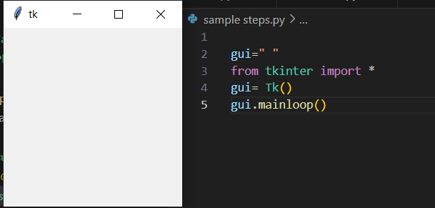
VSCODE TKINTER
Tkinter a Python Library used to construct basic graphic user interface
From Tkinter Import * - allows to import all the Pubic Names (Function, classes and variables ) to current space
Gui variable has been taken to store TK() Library
Basic Gui calculator with the code
gui=Tk()
gui.mainloop()

Slide 5
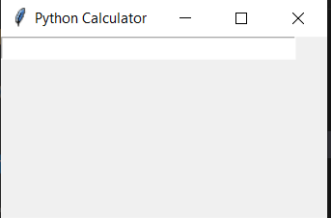
GUI Window-Calculator
Global expression
expression =expression+ str(num)
Pointing out the global expression variable and concatenation of string
String Variable is the variable class , instance of the class been created
Text entry box has been created to show the expression field
grid method is used to place the widgets
at respective positions at the Table like structure
equation = StringVar()
expression_field = Entry(gui, textvariable=equation)
expression_field.grid(columnspan=4, ipadx=60)
Out Put Screen

Slide 6
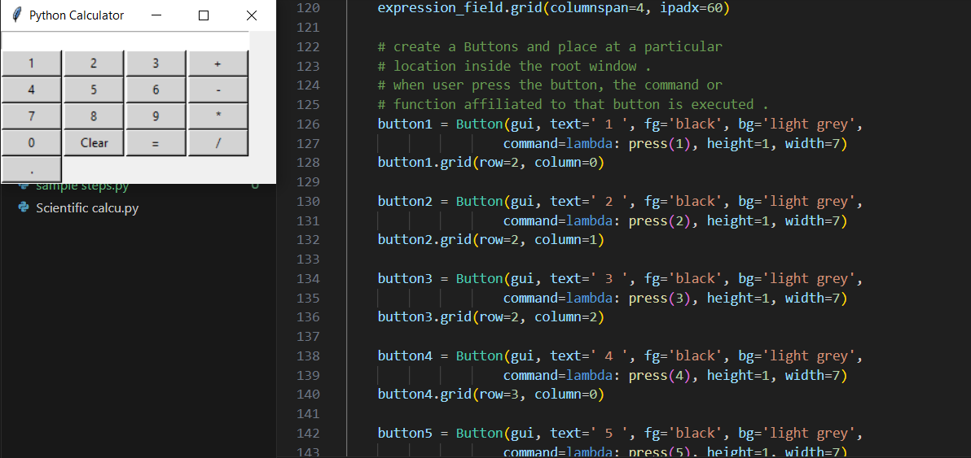
Feature Based Key Buttons
Initially Buttons like 1,2,3,4 were
created and placed in grid with below command
button1 = Button(gui, text=' 1 ', fg='black',
bg='light grey',command=lambda: press(1),
height=1, width=7)
button1.grid(row=2, column=0)
On the first row 1,2,3 and + buttons were placed on grid
Command Lambda on Press was used

Slide 7
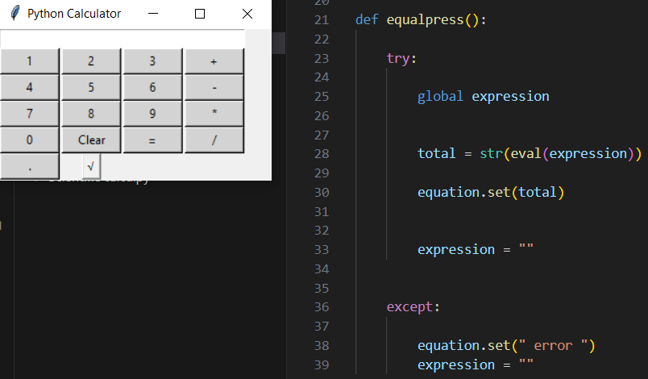
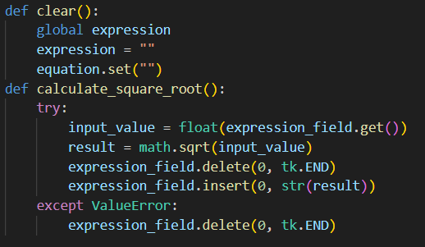
Clear, Equal , Click and Sqr Root Buttons
Clear , EqualPress , Press Buttons function were
created to ensure operations of the operator
Clear()- This function set the contents clear
EqualPress()- It is used to handle the equal
button to execute and show the result
Press()- It handles the button click on
numeric buttons to show on the operation
Square_root()- This function used to find
square root of number using Math library

Slide 8
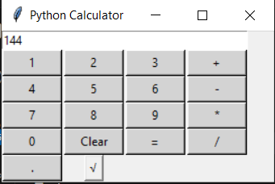
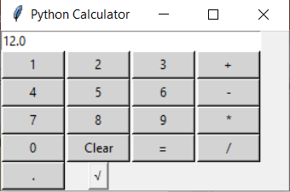
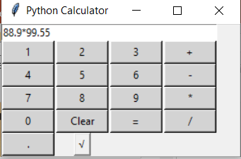
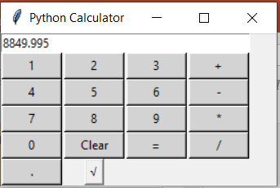
GUI Calculator Operations Square Root and Fraction Multiplications

Slide 9
Conclusion
Different functions in Tkinter facilitates the making of Caculator convenient
GUI calculator is easy to use-All operators and numbers are at a single click
GUI calculator is easy to communicate than text
Custom Themes of Calculator by adjusting color, fonts, layout , Tkinter facilitates that features to create an appealing calculator

Slide 10
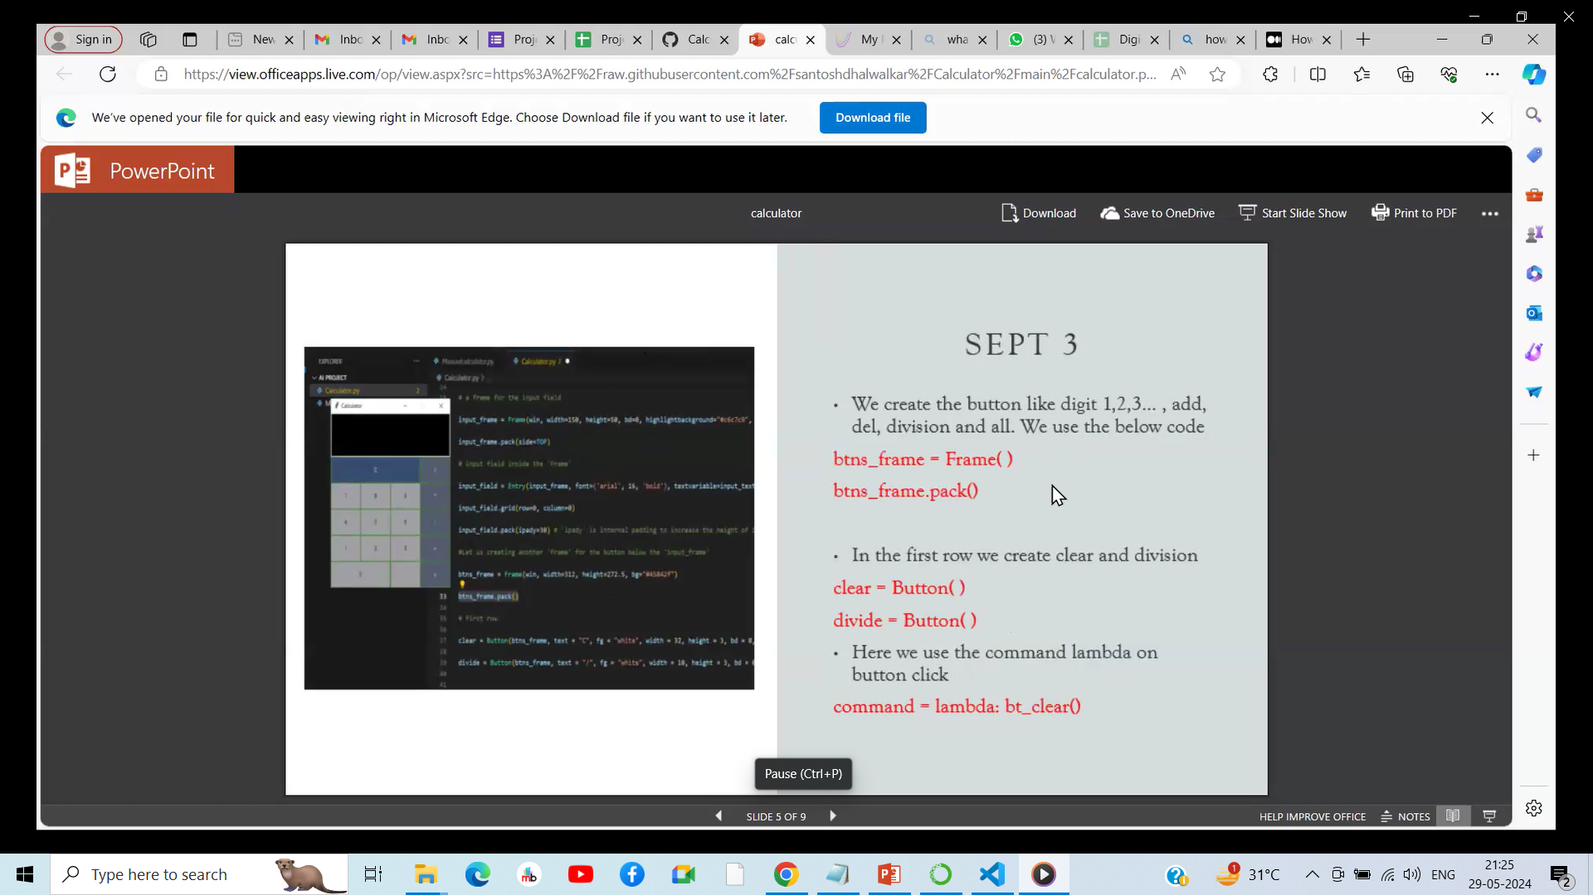

Slide 11
